Slide 1
PostGIS v praxi
Michal Páleník
www.palenik.sk/open-data

Slide 2
About me
PostgreSQL user
my sites
www.oma.sk
www.freemap.sk - mainly routing
www.palenik.sk

Slide 3
coordinate system
projection
import
SQL commands
lessons learned
other than postGIS
ako blafovať o GIS

Slide 4
Coordinate system
WGS84,
S-JSTK
Europe is moving away from north america by 2,5 cm per year

Slide 5
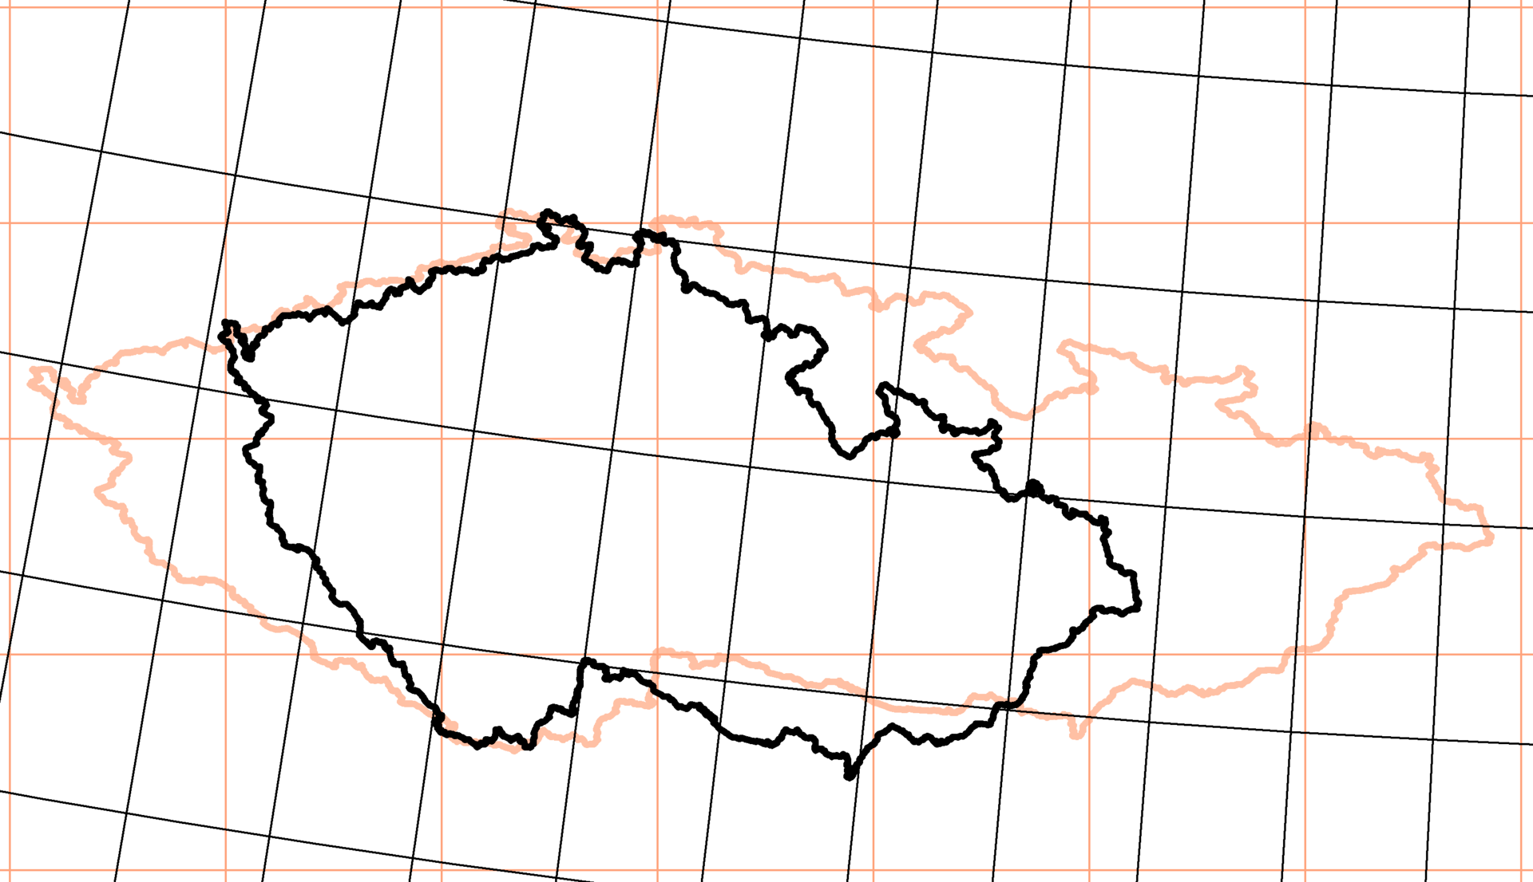
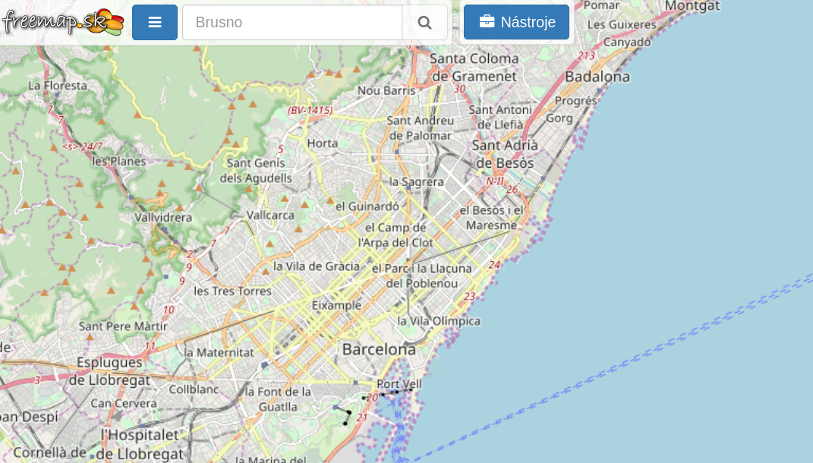
Projection
Krovak
Mercator
northeast is northeast
area is not the same
more

Slide 6
Free Data
OpenStreetMap
ODbL licence
https://planet.osm.org/
48 GB PBF

Slide 7
Import
osm2pgsql, imposm, osmosis, osm2pgrouting
install PostGIS
apt install postgresql-10-postgis-2.4
„CREATE EXTENSION postgis;“

Slide 8
OSM structure
nodes, ways, relations
+ tags (name, created_by, ...)
https://wiki.osm.org/wiki/Map_Features
not fixed list of tags
nodes – lat,lon + tags
ways – list of ordered nodes + tags
relations – list of ordered nodes/ways/relations with roles + tags

Slide 9
import.style
node,way amenity text polygon
node,way boundary text polygon
node,way admin_level text polygon
way building text polygon
node,way route text linear

Slide 10
import
wget -O /tmp/cr.pbf http://download.geofabrik.de/europe/czech-republic-latest.osm.pbf
osm2pgsql --create --slim --latlong --hstore --hstore-match-only --style import.style --database mapnik --prefix 'p2d2' --multi-geometry /tmp/cr.pbf

Slide 11
\d p2d2_point
Table "public.p2d2_point"
Column | Type | Collation | Nullable | Default
-------------+----------------------+-----------+----------+---------
osm_id | bigint | | |
amenity | text | | |
boundary | text | | |
admin_level | text | | |
route | text | | |
tags | hstore | | |
way | geometry(Point,4326) | | |
Indexes:
"p2d2_point_osm_id_idx" btree (osm_id)
"p2d2_point_way_idx" gist (way)

Slide 12
list of pubs
select * from p2d2_point
where amenity='pub';
… where amenity in ('pub','bar','night_club');
select … from p2d2_point ... union select … from p2d2_polygon…;
… select st_centroid(way) as way from p2d2_polygon;

Slide 13
find Prague
select tags->'name', amenity, boundary, admin_level from p2d2_polygon where tags->'name'='Praha';
?column? | amenity | boundary | admin_level
----------+------------+----------------+-------------
Praha | | administrative | 4
Praha | | administrative | 8
Praha | restaurant | |
(3 rows)

Slide 14
find Prague
select osm_id, tags->'name', round(st_area(geography(way))) as area, amenity, boundary, admin_level from p2d2_polygon where tags->'name'='Praha';
osm_id | ?column? | area | amenity | boundary | admin_level
-----------+----------+-----------+------------+----------------+-------------
-435541 | Praha | 496267633 | | administrative | 4
-439840 | Praha | 496267633 | | administrative | 8
229015602 | Praha | 667 | restaurant | |
https://www.openstreetmap.org/relation/435541

Slide 15
list of pubs in Prague
select osm_id, tags->'name' as name, st_distance(prague, way) from (select way as prague from p2d2_polygon where osm_id=-435541) as prague, p2d2_point where amenity='pub' order by st_distance(prague, way);
osm_id | name | st_distance
------------+---------------------------------------------+---------------------
895771091 | Satanka | 0
1276242990 | Podkováň | 0
2605824558 | | 0
5692990062 | Výčep Fialka | 0
2258947412 | U Zdi | 0
6211307175 | Vysočanská hospůdka | 0
…
662841126 | U pěti šišek (Na Hřišti) | 0.248208919961008
3742323860 | Zájezdní hostinec | 0.250725585008008
3735982182 | Pivovarská restaurace Suchomasty | 0.252897378397426
3727647110 | Kovárna | 0.254191911979901 ????

Slide 16
list of pubs in Prague
select osm_id, tags->'name' as name, st_distance(geography(prague), geography(way)) from (select way as prague from p2d2_polygon where osm_id=-435541) as prague, p2d2_point where amenity='pub' order by st_distance(prague, way);
osm_id | name | st_distance
------------+---------------------------------------------+-----------------
…
662841126 | U pěti šišek (Na Hřišti) | 18019
3742323860 | Zájezdní hostinec | 27631
3735982182 | Pivovarská restaurace Suchomasty | 20599
3727647110 | Kovárna | 28005

Slide 17
geometry vs. geography
geography: WGS84 and distances in meters
geometry: more functions, faster
but strange distances

Slide 18
list of pubs in Prague
explain select osm_id, tags->'name' as name, st_distance(geography(prague), geography(way)) from (select way as prague from p2d2_polygon where osm_id=-435541) as prague, p2d2_point where amenity='pub' order by st_distance(prague, way);
QUERY PLAN
-----------------------------------------------------------------------------------------------------------
Sort (cost=7122.22..7132.29 rows=4029 width=56)
Sort Key: (st_distance(p2d2_polygon.way, p2d2_point.way))
-> Nested Loop (cost=0.29..6880.95 rows=4029 width=56)
-> Index Scan using p2d2_polygon_osm_id_idx on p2d2_polygon (cost=0.29..8.31 rows=1 width=2464)
Index Cond: (osm_id = '-435541'::integer)
-> Seq Scan on p2d2_point (cost=0.00..5543.07 rows=4029 width=242)
Filter: (amenity = 'pub'::text)
explain select osm_id, tags->'name' as name from (select way as prague from p2d2_polygon where osm_id=-435541) as prague, p2d2_point where amenity='pub'
and st_contains(prague, way);
QUERY PLAN
-----------------------------------------------------------------------------------------------------
Nested Loop (cost=5.44..446.36 rows=1 width=40)
-> Index Scan using p2d2_polygon_osm_id_idx on p2d2_polygon (cost=0.29..8.31 rows=1 width=2464)
Index Cond: (osm_id = '-435541'::integer)
-> Bitmap Heap Scan on p2d2_point (cost=5.15..438.03 rows=1 width=242)
Recheck Cond: (p2d2_polygon.way ~ way)
Filter: ((amenity = 'pub'::text) AND _st_contains(p2d2_polygon.way, way))
-> Bitmap Index Scan on p2d2_point_way_idx (cost=0.00..5.15 rows=116 width=0)
Index Cond: (p2d2_polygon.way ~ way)

Slide 19
pub 354988465 „500“ is closed!!!
select osm_id, amenity, tags->'name', round(st_distance(mypub, geography(way))) as vzd from p2d2_point, (select geography(way) as mypub from p2d2_point where osm_id=354988465) as mypub where amenity is not null order by st_distance(mypub, geography(way)) limit 20;
osm_id | amenity | ?column? | vzd
------------+-----------------+----------------------------------+-----
354988465 | restaurant | Restaurant 500 (pětistovka) | 0
354988470 | recycling | | 34
619170327 | toilets | Veřejné WC | 75
3413954378 | pharmacy | Hradčanská lékárenská společnost | 81
4534896182 | bicycle_parking | | 89
3413954377 | bank | Česká spořitelna | 92
4690862415 | shelter | | 106
5713651736 | restaurant | Veganland | 111
3778159289 | recycling | | 112
6631111325 | vending_machine | | 114
309290158 | cafe | Costa Coffee | 115

Slide 20
500 is closed!!!
select osm_id, amenity, tags->'name', tags->'opening_hours' as opening_hours, round(st_distance(mypub, geography(way))) as vzd, degrees(st_azimuth(mypub, geography(way))) as azimuth from p2d2_point, (select geography(way) as mypub from p2d2_point where osm_id=354988465) as mypub where amenity in ('pub','restaurant','bar') and st_dwithin(mypub, geography(way), 500) order by st_distance(mypub, geography(way)) limit 10;
osm_id | amenity | ?column? | opening_hours | vzd | azimuth
354988465 | restaurant | Restaurant 500 (pětistovka) | | 0 |
5713651736 | restaurant | Veganland | Mo-Sa 10:30-21:00 | 111 | -65.2499571149107
331960839 | restaurant | Mash Hana | | 157 | 60.6542133671608
309290156 | restaurant | Na Hradčanské | | 174 | -83.0821047661996
307338919 | restaurant | Sokolovna | Mo,Tu 10:00-23:00; We-Fr 10:00-24:00; Sa,Su 11:00-23:00 | 186 | -20.4087586432402
360039727 | pub | Krkonošská hospůdka | | 206 | 18.02128027214
2657339378 | restaurant | Yam yam | | 279 | -39.6975318875035
3156994661 | restaurant | à table! | | 296 | -38.1917875435709
354984792 | restaurant | Indian by Nature II | | 299 | -43.5924578972126
360039737 | restaurant | Na Rozhraní | Mo-Fr 11:00-23:30, Sa 11:30-23:30, Su 12:00-22:00 | 299 | -5.8246485869541

Slide 21
pubs close to tram 22
https://www.openstreetmap.org/relation/8060768
select tags->'name' as name, round(st_distance(geography(way), tram)) as dist
from p2d2_point,
(select geography(way) as tram from p2d2_line where osm_id=-8060768) as tram
where st_dwithin(geography(way), tram, 200) and geography(way) && tram and amenity='pub';

Slide 22
pubs in Prague by segregation
select pubs1.osm_id, first(pubs1.tags->'name') as name, count(*) as pocet, array_agg(pubs2.osm_id) as other
from (select * from (select way as prague from p2d2_polygon where osm_id=-435541) as prague, p2d2_point where amenity='pub' and st_contains(prague, way)) as pubs1
left outer join (select * from (select way as prague from p2d2_polygon where osm_id=-435541) as prague, p2d2_point where amenity='pub' and st_contains(prague, way)) as pubs2
on pubs1.osm_id != pubs2.osm_id and st_dwithin(geography(pubs1.way), geography(pubs2.way), 1000) group by pubs1.osm_id order by count(*) desc;

Slide 23
least segregated:
4248794095 | Klub Buben | 40
4248794094 | Sport Pub | 39
2408146791 | Hostinec Slavíkova | 39
355008175 | Krčma U Parašutistů | 39
4184471426 | Rocky O' Reillys Irish Pub | 38
296601430 | Belzepub | 38
1832498512 | U Kacíře | 38
331960300 | U Žaludů | 38
2420223836 | Na Schůdku | 38
331960299 | Milá tchýně | 38
355008194 | Vínko Charlie | 37
3457334001 | Trafika BAR | 37
4197006861 | Branická Formanka | 37
4326615089 | Vape House Prague | 36
552405058 | Hostinec u Rotundy | 36

Slide 24
most segregated
309103062 | U žraloka | 1 | {309103011}
2614956474 | Palpost | 1 | {NULL}
6357245380 | Hospoda U lesa | 1 | {NULL}
309103011 | Bar & Vinárna | 1 | {309103062}
7042015085 | Restaurace Pivovar Řeporyje | 1 | {2167490020}
1143014989 | Na Korunce | 1 | {NULL}
1109692879 | Jako doma | 1 | {NULL}
4438779796 | Hurdálkova chýše jedová | 1 | {1712556993}
4323521297 | Spartak | 1 | {NULL}
1008212347 | | 1 | {NULL}
4257560092 | Hospoda Konrad | 1 | {NULL}
296804168 | | 1 | {NULL}
1403144336 | U Kubíčků | 1 | {1736152126}
4515217790 | U Huberta | 1 | {NULL}
1409474794 | Na Hřišti | 1 | {NULL}
4586922093 | Hospůdka U Bobra | 1 | {NULL}
4587023791 | Sportovní hospoda | 1 | {589970268}
1427338969 | | 1 | {NULL} ?? is this it?
2709963362 | U Herčíků | 1 | {3237974418

Slide 25
most segregated
select pubs1.osm_id, first(pubs1.tags->'name') as name,
round(min(st_distance(geography(pubs1.way), geography(pubs2.way)))) as min_dist
from (select * from (select way as prague from p2d2_polygon where osm_id=-435541) as prague, p2d2_point where amenity='pub' and st_contains(prague, way)) as pubs1
left outer join (select * from (select way as prague from p2d2_polygon where osm_id=-435541) as prague, p2d2_point where amenity='pub' and st_contains(prague, way)) as pubs2
on pubs1.osm_id != pubs2.osm_id group by pubs1.osm_id order by min_dist desc;

Slide 26
most segregated
osm_id | name | min_dist
------------+---------------------------------------------+----------
5702007631 | U Beránků | 2689
4323521297 | Spartak | 2030
1143014989 | Na Korunce | 1905
296155831 | | 1799
2378848820 | Útulna | 1542
1008212347 | | 1504
5181640829 | Комо | 1452
2858014134 | U Čížků | 1416
2614956474 | Palpost | 1356

Slide 27
display maps
TMS with OpenLayers or Leaflet or …
images (jpeg,png) in special directory structure
zoom/x/y.jpeg
created by mapnik, …

Slide 28
z/x/y to envelope
CREATE OR REPLACE FUNCTION www.bbox(zoom integer, x integer, y integer) RETURNS geometry
LANGUAGE plpgsql IMMUTABLE PARALLEL SAFE
AS $function$
DECLARE
n float; E float = 2.7182818284; tt float; lat float; lon float;
BEGIN
n = 1.0*power(2.0, zoom);
tt=pi() - (2.0 * pi() * y) / n;
lat = degrees(atan( (1 - power(E, -2*tt)) / (2 * power(E, -tt)) ));
lon = 360.0 * x / n - 180; --ok
tt=pi() - (2.0 * pi() * (1+y)) / n;
return ST_MakeEnvelope( lon, lat, 360.0 * (1+x) / n - 180, degrees(atan( (1 - power(E, -2*tt)) / (2 * power(E, -tt)) )), 4326);
END;
$function$

Slide 29
MVT in $tile=9,285,177
select st_asmvt(q, 'pubs', 4096, 'geom') as mvt
from (select
st_AsMvtGeom(way, BBox($tile), 4096, 256, true) as geom,
tags->‘name‘ as name, amenity
from p2d2_point where way && Bbox($tile)
) as q;

Slide 30
php code tile server
header("Access-Control-Allow-Origin: *");
header('Content-Type: application/x-protobuf');
header("Content-Disposition: attachment");
$res = pg_query($q); $out = '';
while($r = pg_fetch_assoc($res)) $out .= pg_unescape_bytea($r['mvt']);
echo $out;

Slide 31
html code browser
<div id='map' style='height: 500px; width: 100%;'></div>
<script src='map.js'></script>
plus mapbox-gl.css and mapbox-gl.js

Slide 32
map.js
var simple = {"version": 8, "sources": {
"osm": { "type": "vector", "attribution":"Zrobil <a href='https://www.palenik.sk/'>Michal Páleník</a> vďaka <a href='https://www.openstreetmap.org'>prispievateľom OpenStreetMap</a>", "minzoom": 5, "maxzoom": 17,
"tiles": ["https://tiles.epsilon.sk/zaklad/{z}/{x}/{y}.pbf"] }, },
"glyphs": "https://tiles.epsilon.sk/fonts/{fontstack}/{range}.pbf",
"layers": [ { "id":"pubs", "type":"circle", "source":"osm", "source-layer": "pubs",
"paint": { "circle-color": [ "case", ["==", ["get","amenity"], "pub"], "blue", ["==", ["get","amenity"], "restaurant"], "green", "yellow"], "fill-opacity": 0.7, "circle-radius": 4 },
} ]};
var map=new mapboxgl.Map({ container: "map", style: simple, zoom: 9, center: [21.24, 48.84], minZoom: 5 });
map.addControl(new mapboxgl.NavigationControl()); map.dragRotate.disable();

Slide 33
http://project-osrm.org/
real distances
PostGIS used to create better routes
prefer routes in forests
no function ST_RealDistance(point1,point2,mode)
call osrm library, return foot/bicycle distance/linestring between points
without http calls
(easy to do with http json calls)

Slide 34
lessons learned
SSD, shared_buffers, …
MVCC:
one ten-page insert is far faster than 5 updates
indexes
select .. where st_distance(a,b)<400; --slow
select .. where st_dwithin(a,b,400);

Slide 35
create tables
create table tmp_schema.my_table as select …
12 hours
check if number of rows is > 10
or other basic quality control
begin; drop table live.my_table;
alter table tmp_schema.my_table set schema live;
commit;

Slide 36
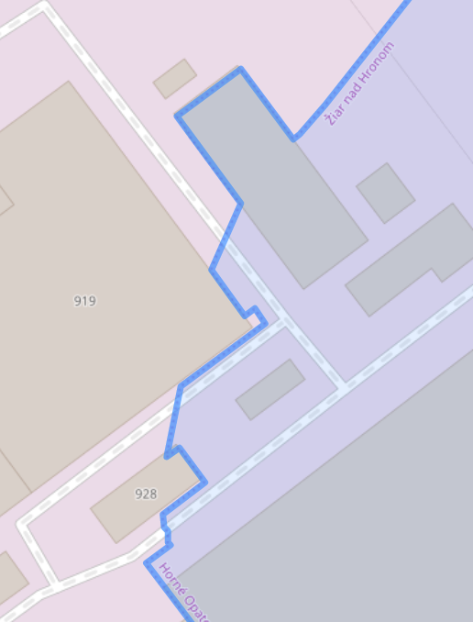
Some small details
some borders are strange:
combination of
ST_Buffer
ST_SimplifyPreserveTopology
I would need:
st_??(g1,g2,dst1,dst2)
return true if they are closer than dst1
return false if more than dst2
return anything fast if between dst1 and dst2

Slide 37
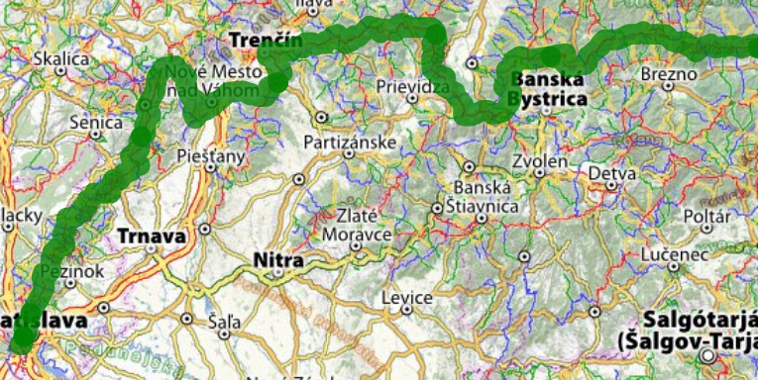
&&
… where g1 && g2
return true if bounding boxes of g1 and g2 overlap
very, very fast
some very big routes exist
turistika.oma.sk/e8

Slide 38
thank you
Michal Páleník
https://www.palenik.sk/open-data

